Slide 1
Introductory AI/ML Course
By Ayaan Haque and Viraaj Reddi
Notes:
Ayaan

Slide 2
Course Curriculum
Week 1: Introduction to Artificial Intelligence (AI) and Machine Learning (ML)
Week 2: Overview of Machine Learning concepts
Week 3: Machine Learning Code
Week 3: Overview of Deep Learning
Week 5: Convolutional Neural Networks
Week 6: Keras CNN Walkthrough
Week 7-8: Projects
Our Github Repository: https://github.com/Intro-Course-AI-ML/LessonMaterials
Notes:
Ayaan

Slide 3
Week 1: Intro to AI/ML
Notes:
Ayaan

Slide 4
Prerequisites
To succeed, you will need some familiarity with computer programming. Artificial Intelligence is a pretty complicated topic, so you should definitely brush up on basic computer programming beforehand
We will be using Python in this course
If you are a bit rusty or not familiar with Python, however, you should still be fine.
Notes:
Viraaj

Slide 5
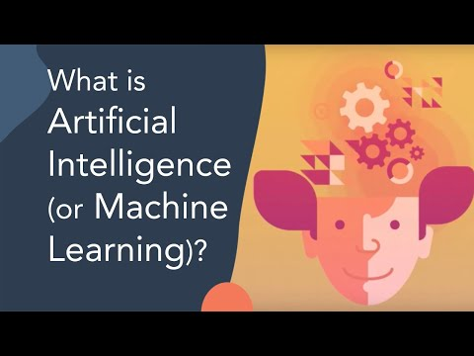
Intro Video
Notes:
Viraaj

Slide 6
AI is everywhere
AI is not the common misconception of robots taking over. In fact, AI is already widely in use in all different fields!
AI is used in:
Virtual Assistants
Security
Healthcare and Medical Imaging Analysis
Your phone
Netflix
Google searches are AI
Notes:
Viraaj

Slide 7
What is AI?
Definition: The simulation of human intelligence in machines that are programmed to think and act like humans.
A program learns from its own results, using thousands of tests to gradually get closer to its goals
The program mimics how humans gradually learn from their surroundings by doing the same in their virtual environment
There are multiple types of AI used for different situations -- Computer Vision for understanding images, NLP for understanding human communication (e.g. speech and text), and many more
Notes:
Ayaan

Slide 8
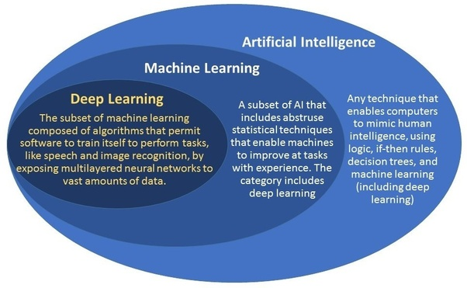
AI vs ML
AI Definition: The simulation of human intelligence in machines that are programmed to think and act like humans.
ML Definition: The practice of using algorithms to analyze data, learn from that data, and then make a determination or prediction about new data.
Notes:
Ayaan

Slide 9
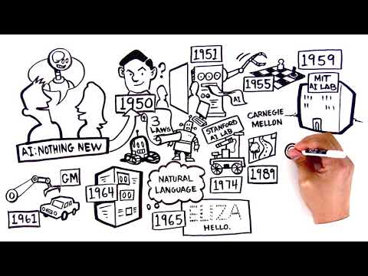
History of AI
The field of AI wasn't formally founded until 1956 at a conference at Dartmouth College, where the term "artificial intelligence" was coined.
In 1997, IBM's Deep Blue became the first computer to beat a chess champion when it defeated Russian grandmaster Garry Kasparov. And in 2011, the computer giant's question-answering system Watson won the quiz show "Jeopardy!" by beating reigning champions Brad Rutter and Ken Jennings.
Notes:
Viraaj

Slide 10
Types of AI
Computer Vision: https://machinelearningmastery.com/what-is-computer-vision/
NLP: https://machinelearningmastery.com/natural-language-processing/
Recommendation Systems: https://developers.google.com/machine-learning/recommendation/collaborative/basics
Deep Learning: https://machinelearningmastery.com/what-is-deep-learning/
Notes:
Ayaan

Slide 11
Practical Applications of AI
AI is extensively used in:
Healthcare: https://www.forbes.com/sites/bernardmarr/2018/07/27/how-is-ai-used-in-healthcare-5-powerful-real-world-examples-that-show-the-latest-advances/#3dd5aeb95dfb
Sustainability: https://www.youtube.com/watch?v=mJ6rjJiIHyo
Business: https://www.youtube.com/watch?v=N_eHmaRf9T4
Economics: https://www.youtube.com/watch?v=0BAFOJbo4W4
Notes:
Viraaj

Slide 12
Ethics of AI
There is very little regulation surrounding AI considering how new it is, but there are various ethical questions about how far to take this technology
Stanford article summarizing ethics of AI
Some of the big questions:
How can we ensure a right to privacy and knowledge of surveillance?
Will AI ever be able to do things on its own?
Far reached example, but think Ultron from Avengers
How will AI impact employment and jobs?
How do we hold AI accountable? Who is responsible for their actions when they fail?
^there are many more questions like this that ethicists have to grapple with
Notes:
Ayaan

Slide 13
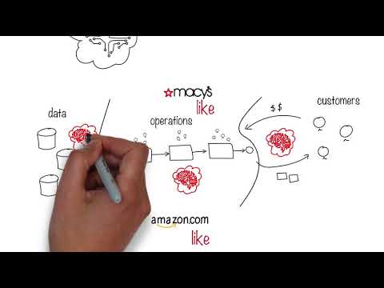
Video -- Ethics of AI(How it hurts employees)
Notes:
Viraaj

Slide 14
Data
Data is extremely important for Machine Learning specifically
Machines learn from being exposed to huge amounts of data, and the more data that is present, the more these machines are able to adapt and learn
Larger data is important
One of the best resources for data:
https://www.kaggle.com/
Notes:
Viraaj

Slide 15
How AI will help you
College Applications:
Potential Major in CS, Engineering
Then AI will be very useful
There's no AI/ML major yet, but it might be a thing in the future
AI is the future in careers:
Every career is gradually integrating AI, and developing a foundation in AI will assist you wherever you choose to go
Regardless of what you want to pursue, AI will most likely be important
Viraaj wants to be a doctor, but he still learns AI because of its vast potential and application in healthcare
Notes:
Ayaan

Slide 16

Setting up google colaboratory
Google colab: A free integrated development environment (IDE) hosted by Google that allows you to run your Python code
Notes:
Ayaan

Slide 17
Learning Github
We will be using Github as our primary source of storing and sharing code and materials for this course
All of you should make Github accounts and we will teach you how to share your code on github using Github Desktop.
All of you should make your own repository where you will make a folder for your practice code as well as a folder for your actual project when you make it
https://lab.github.com/githubtraining/introduction-to-github
Notes:
Ayaan

Slide 18
Important Python Libraries
Pandas
Numpy
Tensorflow/Keras
Matplotlib
Pytorch
Sci-kit Learn
In this course, we will use Pandas, Numpy, and Keras
Notes:
Viraaj

Slide 19
HW: Python Brush Up
General python reference center: https://www.w3schools.com/python/
Using python with google colab: https://towardsdatascience.com/how-to-practice-python-with-google-colab-45fc6b7d118b
While not all of you may have experience with Python, as long as you understand the basic concepts of coding, you should be fine. If not, make sure to ask questions and we will do our best to support you.
Check out these notebooks and learn them:
https://colab.research.google.com/notebooks/intro.ipynb
https://colab.research.google.com/notebooks/charts.ipynb
Notes:
Ayaan

Slide 20
Questions?
If you guys have any questions, just leave them in the comments! We will answer quickly.
You can also create an issue on our Github repository. We will be quickest to respond there, and if you ever have code issues, you can copy your code there and it will be the nicest.
Lastly, we would love if you guys would join the Github organization! You can follow along with our code and upload your code and share it with the rest of the members.
To be invited, create an issue or shoot one of us an email
ayaanzhaque@gmail.com, viraajreddi@gmail.com
Notes:
Ayaan/Viraaj

